Slide 1

COOKIEs? COOKIES!
Tracking Data Across Multiple Pages

Slide 2
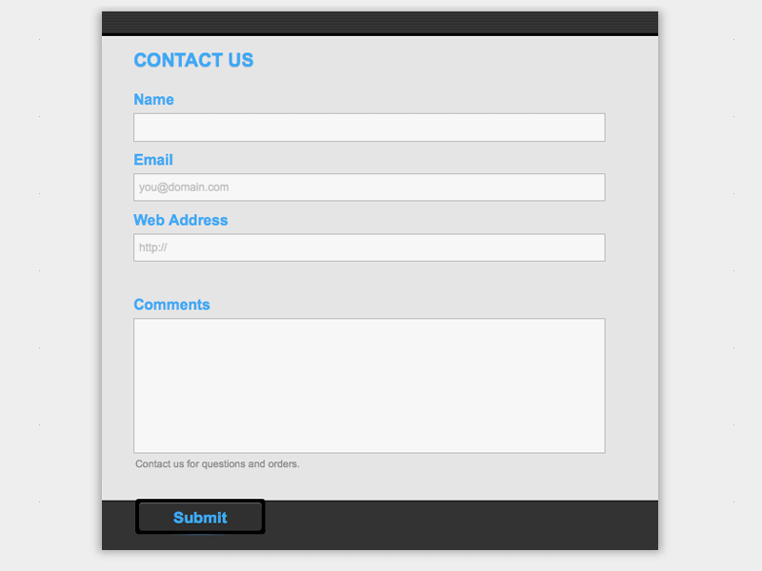
The Problem
process-form.php
$_POST[“Name”]
$_POST[“Email”]
$_POST[“……”]

Slide 3
The Problem
process-form.php
$_POST[“Name”]
$_POST[“Email”]
$_POST[“……”]
some-page.php
???

Slide 4
The Problem
process-form.php
$_POST[“Name”]
$_POST[“Email”]
$_POST[“……”]
some-page.php
???
<?php $_COOKIE[“mycookie”] ?>

Slide 5
HOW TO SET A COOKIE IN PHP
<?php
setcookie(“mycookie”, “whatever I want to store”);
?>

Slide 6
HOW TO GET THE INFORMATION STORED IN A COOKIE
<?php
echo $_COOKIE[“mycookie”];
?>

Slide 7
The Result
some-page.php
some-page2.php
<?php
setcookie(
“mycookie”,
“whatever I want to store”
);
?>
<?php
echo $_COOKIE[“mycookie”]
?>
<?php
echo $_COOKIE[“mycookie”]
?>
whatever I want to store
whatever I want to store

Slide 8
How Does This Help Us?
Login Process
User types in a username and password
If they are valid (compare to database), “log the user into your site”
Create a cookie that your site will use to check if the user is logged in
Use cookies to identify which user is logged into your site
Decide what to do if the cookie is missing or invalid
Shopping Carts
User adds an item to their cart
Create a cookie that tracks what the user has “in their shipping cart”
Update the cookie as needed (adding new items, removing items, changing quantities)
Use the cookie information at checkout

Slide 9
Sessions? Sessions!
Securely Track Data Across Multiple Pages

