Slide 1
Database-Generated Content Pages

Slide 2
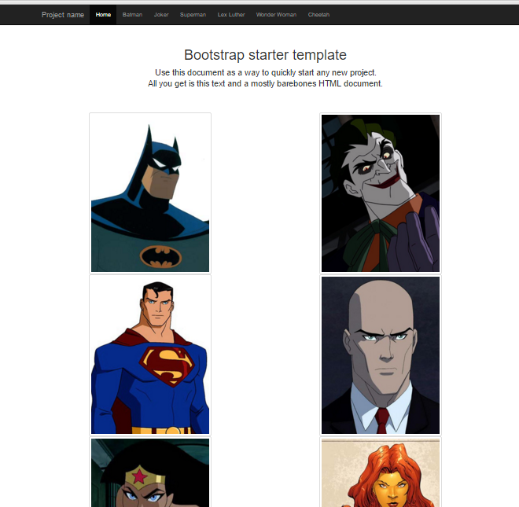

Slide 3
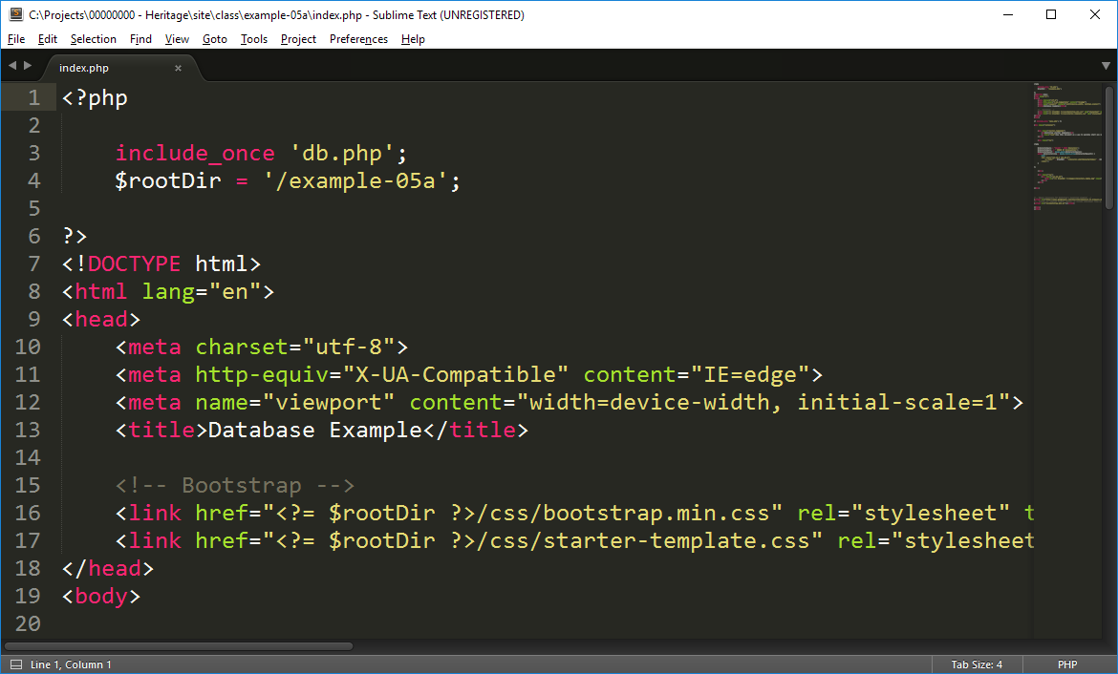

Slide 5
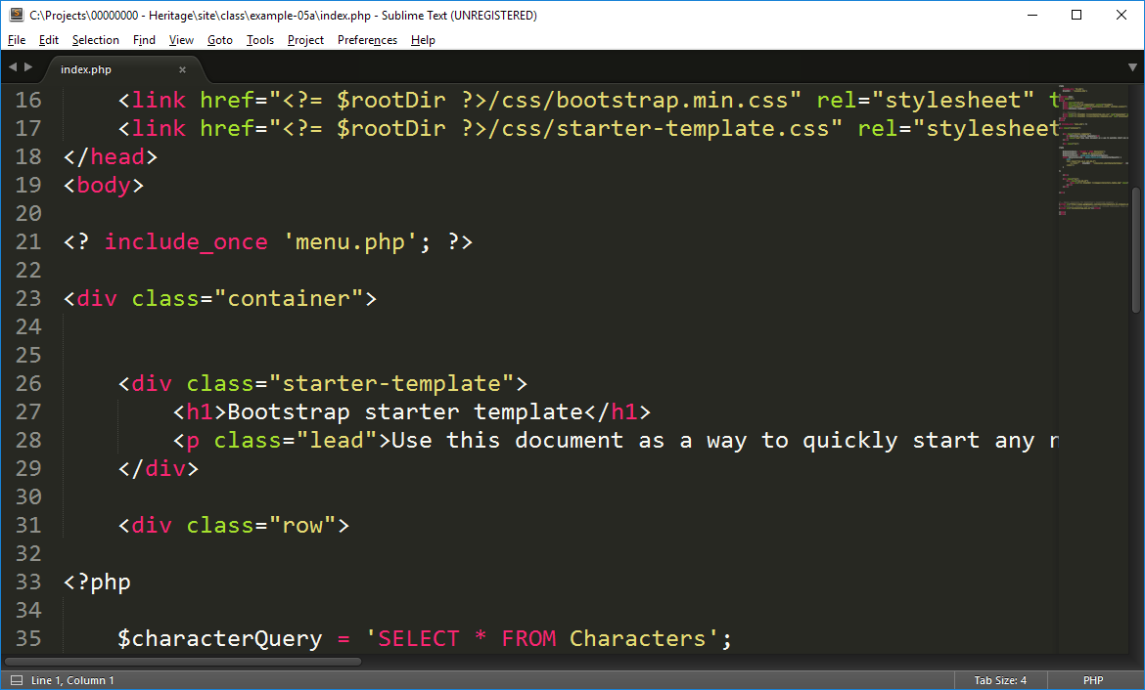

Slide 7
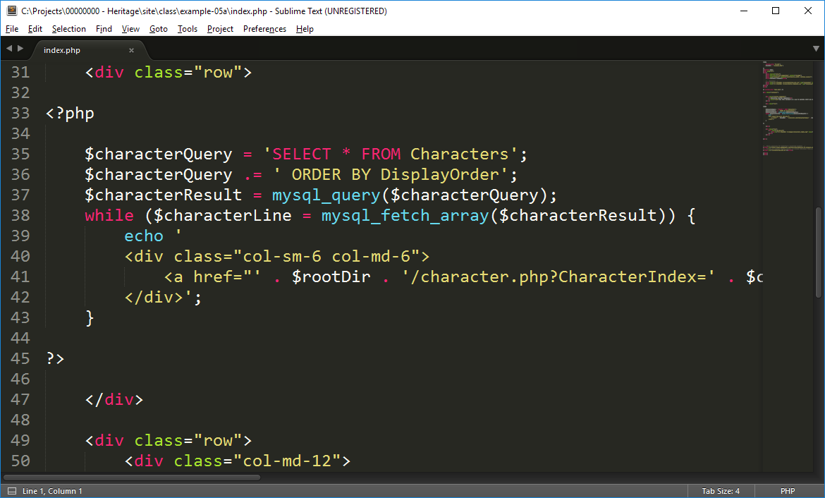

Slide 10
<a HREF=“”><IMG SRC=“”></a>
We using an image as a link to a character page. The character page is identified using a CharacterIndex which refers to a specific row in our table.
<a href="' . $rootDir . '/character.php?CharacterIndex=' . $characterLine["CharacterIndex"] . '">
<img src="' . $rootDir . '/images/' . $characterLine["Image"] . '" class="img-thumbnail img-responsive" />
</a>
$rootDir = “/example-05a/”
$characterLine = [refers to the database table Characters]
[“CharacterIndex”] = [used to identify the character we want to show]
[“Image”] = [the image filename for the character we want to show]

Slide 11
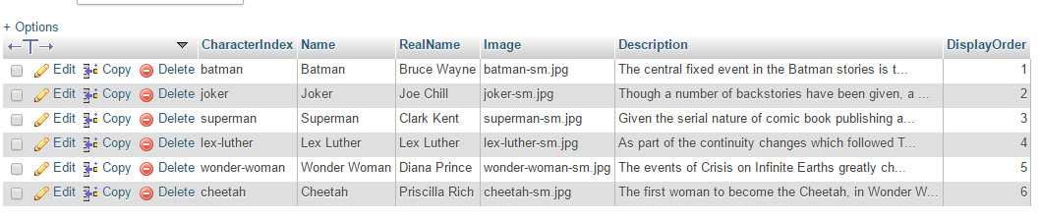
<a HREF=“”><IMG SRC=“”></a>
We using an image as a link to a character page. The character page is identified using a CharacterIndex which refers to a specific row in our table.
<a href="' . $rootDir . '/character.php?CharacterIndex=' . $characterLine["CharacterIndex"] . '">
<img src="' . $rootDir . '/images/' . $characterLine["Image"] . '" class="img-thumbnail img-responsive" />
</a>
$rootDir = “/example-05a/”
$characterLine = [refers to the database table Characters]
[“CharacterIndex”] = [used to identify the character we want to show]
[“Image”] = [the image filename for the character we want to show]

Slide 14
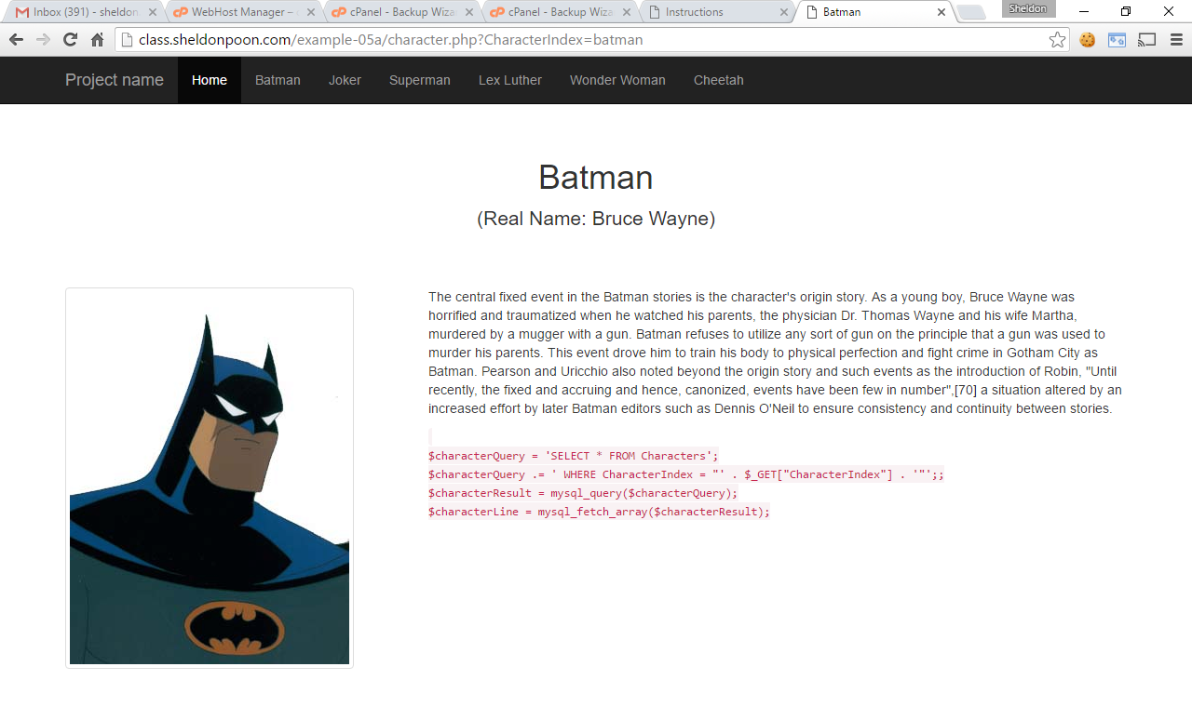

Slide 17
$characterLine[“CharacterIndex”] = batman
$characterLine[“Name”] = Batman
$characterLine[“RealName”] = Bruce Wayne
$characterLine[“Image”] = batman-sm.jpg
$characterLine[“Description”] = [description from db]

Slide 19
$characterLine[“Name”]
$characterLine[“RealName”]
$characterLine[“Description”]
$characterLine[“Image”]

