Slide 1
Looping Through a Table
Using a while loop

Slide 2
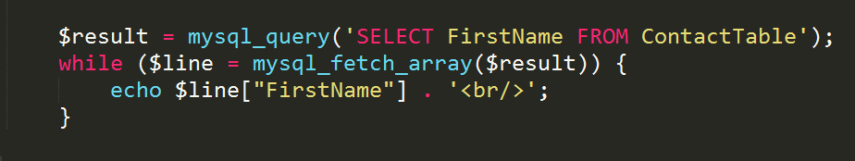
What does this mean???

Slide 3
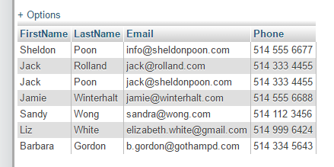
What does this mean???
SELECT [what?] FROM [where?]

Slide 4
What does this mean???

Slide 5
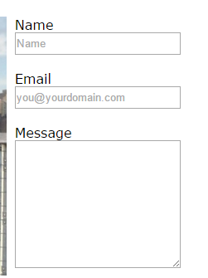
$line is like $_POST
$_POST[“Name”]
$_POST[“Email”]
$_POST[“Message”]

Slide 6
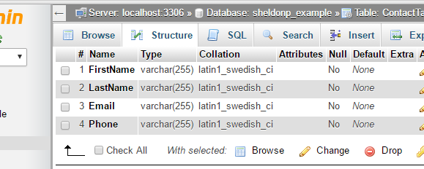
$line is like $_POST
$line[“Name”]
$line[“Email”]
$line[“Message”]

Slide 7
What does this mean???

Slide 8
What does this mean???
$line[“FirstName”] == “Sheldon”

Slide 9
What does this mean???
$line[“FirstName”] == “Jack”

