Slide 1
Introduction to MySQL

Slide 2
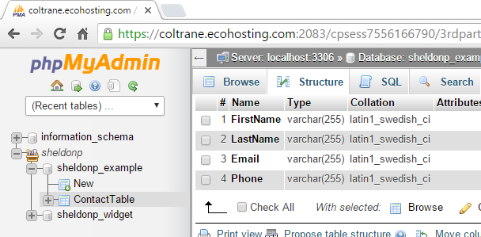
Table Structure

Slide 3
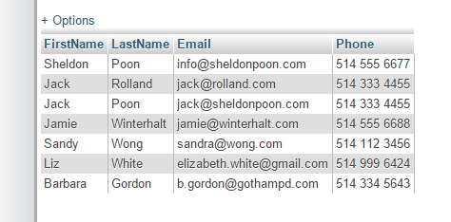
Table Data

Slide 4
Select Data

Slide 5
Select Data
SELECT FirstName, LastName, Email, Phone FROM ContactTable
WHERE FirstName = “Sandy”
AND LastName = “Wong”

Slide 6
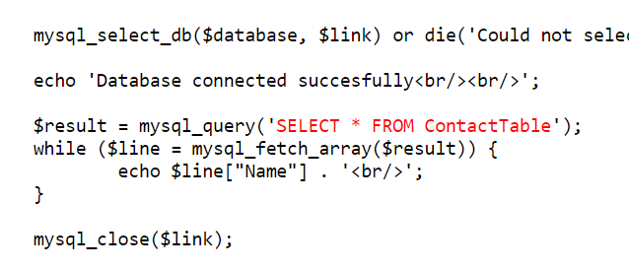
Select Data
SELECT FirstName, LastName, Email, Phone FROM ContactTable
WHERE FirstName = “Sandy”
AND LastName = “Wong”

