Slide 1
Forms
How to capture user data

Slide 2
Basic Structure
User Input
(HTML form)
Process Data
(PHP File)
($_POST or $_GET)

Slide 3
Basic Structure
User Input
(HTML form)
Process Data
(PHP File)
($_POST or $_GET)
(Response)
Save Data
(Text File)

Slide 4
Basic Structure
User Input
(HTML form)
Process Data
(PHP File)
($_POST or $_GET)
(Response)
Save Data
(MySQL database)

Slide 5
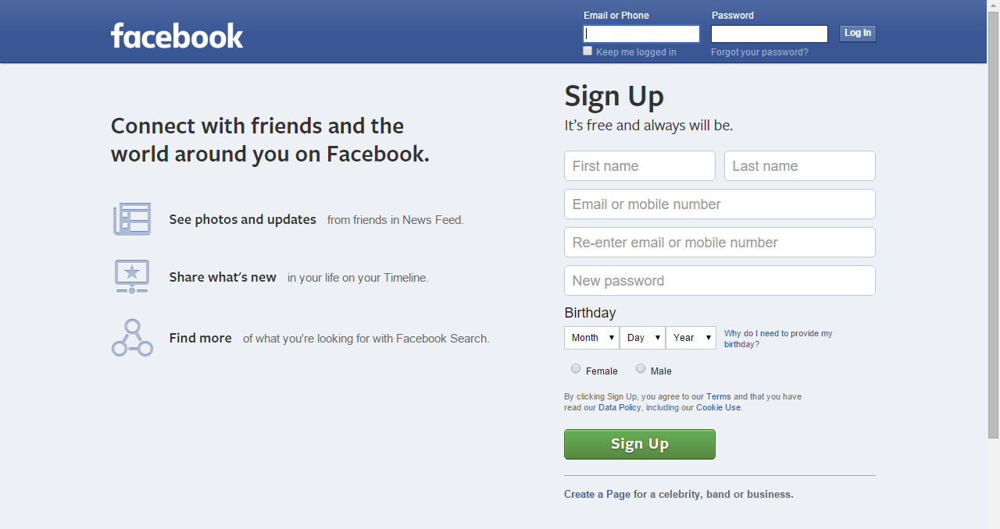

Slide 6
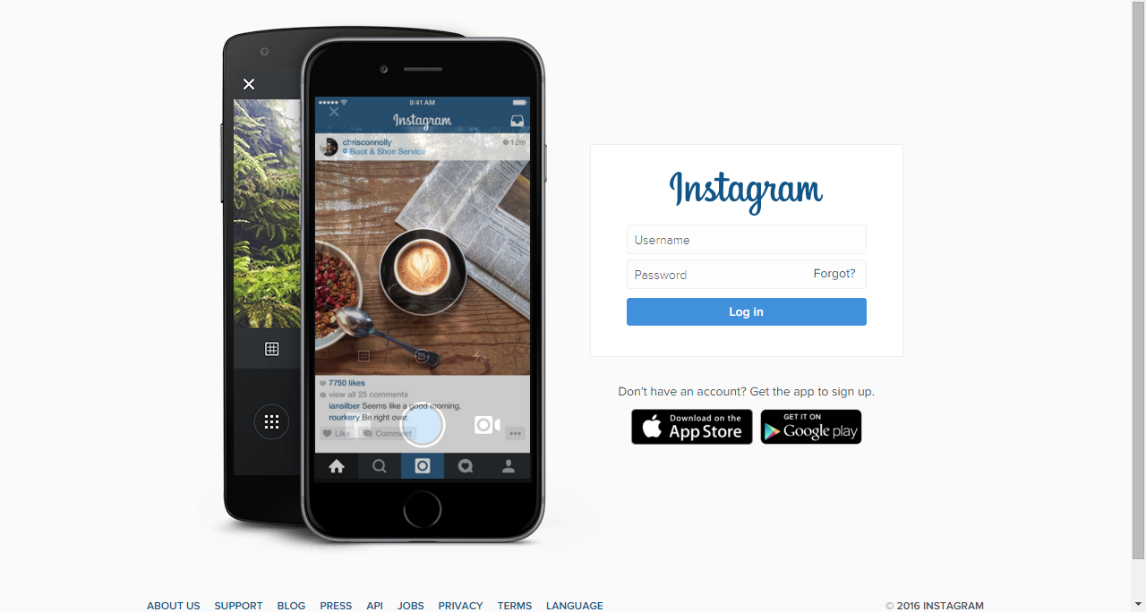

Slide 7
