Slide 1
Is Facebook Evil?

Slide 2
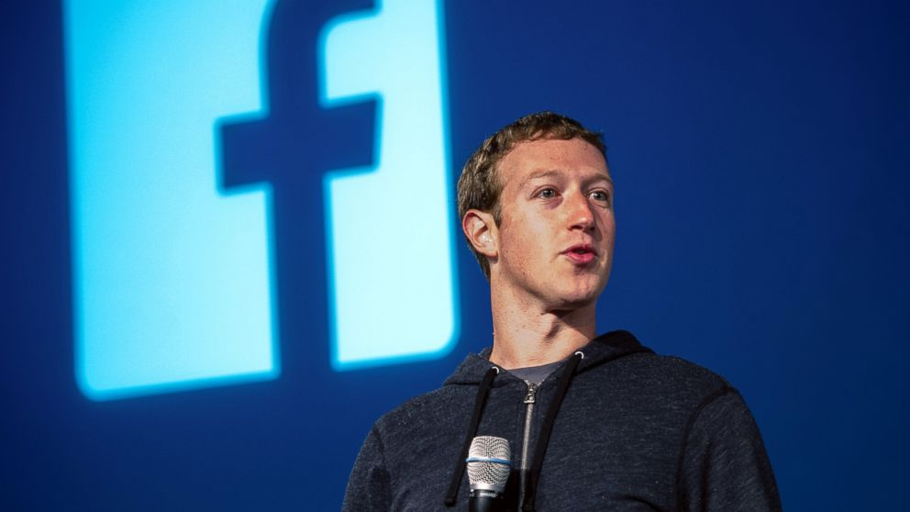
Mark Zuckerberg
Started programming before he was a teenager
Current age: 31
Built Facebook while studying at Harvard
Mark never intended to drop out and would have likely ended up working at Microsoft
… but ended up dropping out at age 20

Slide 3
Mark Zuckerberg
Facebook is currently worth $46 Billion
Mark and his wife pledge to donate the majority of their wealth towards "advancing human potential and promoting equality“
on Dec 1, 2015 Mark and his wife announced that they would donate 99% of their Facebook shares to the Chan Zuckerberg Initiative

Slide 4
What Makes A Company Evil?

Slide 5
Internet.org
Created and currently owned by Facebook (Zuckerberg)
“The initiative is to provide Internet access to the 5 billion people who are not connected”
Currently providing free “internet access” to mobile subscribers in 3rd world countries
Has plans later this year to launch satellites into space to better service countries where infrastructure is lacking

Slide 6
Is There Anything Wrong With What Internet.org Is Doing?

Slide 7
Net Neutrality
noun
the principle that Internet service providers should enable access to all content and applications regardless of the source, and without favoring or blocking particular products or websites.

Slide 8
Corporate Monopoly
A monopoly is a situation in which a single company or group owns all or nearly all of the market for a given type of product or service. By definition, monopoly is characterized by an absence of competition, which often results in high prices and inferior products.

Slide 9
Facebook Mood Alteration Experiment
By creating algorithms that look for patterns and keywords, Facebook was able to identify “happy” posts, “sad” posts, and emotional neutral posts
Researchers then wanted to see if posting only “happy” or only “sad” posts on someone’s feed would in turn affect the target user’s own mood
Facebook's data scientists manipulated the News Feeds of 689,003 users without their knowledge
Users agree to terms and conditions when they sign up. Facebook did nothing to violate these terms and conditions

Slide 10
Is There Anything Wrong With What Facebook Did?

Slide 11
Informed Consent
permission granted in the knowledge of the possible consequences, typically that which is given by a patient to a doctor for treatment with full knowledge of the possible risks and benefits.

Slide 12
Privacy
noun
the state or condition of being free from being observed or disturbed by other people.

Slide 13
Other Questionable Activities
What else is Facebook testing on their user base?

Slide 14
What Makes A Company Evil?

Slide 15
Is Facebook Evil?

