Slide 1
Ethics

Slide 2
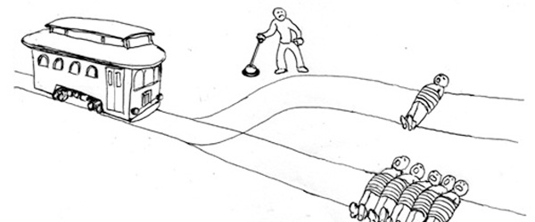
The Trolley Problem

Slide 3
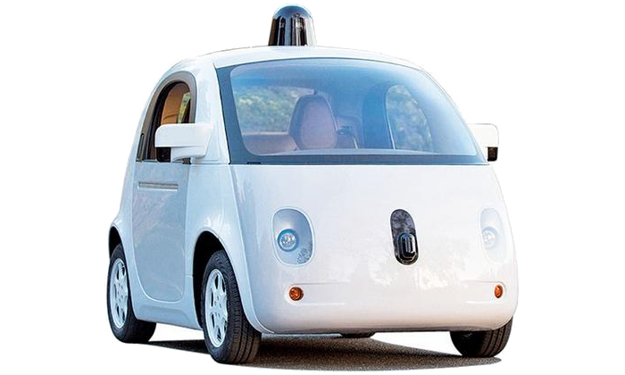
The Trolley Problem

